Slide 1
Usability Engineering Remote Blockweek
Prof. Dr. Christian Reimann, University of Applied Sciences and Arts Dortmund

Slide 2
Module Usability Engineering
Module != Blockweek
Module = Blockweek + Doc + Paper (Writing & Review)
Blockweek (groupwork): practical project work + mini theory lectures (+ documentation)
continuous virtual presence
Overview Paper (groupwork & individual):
writing an overview paper („individual“ groupwork)
reviewing „program commitee style“(„individual“ groupwork)
self organised group work + individual work + consulting
Grading:
40% blockweek (presentation & documentation)
60% paper (writing, reviews, presentation)

Slide 3
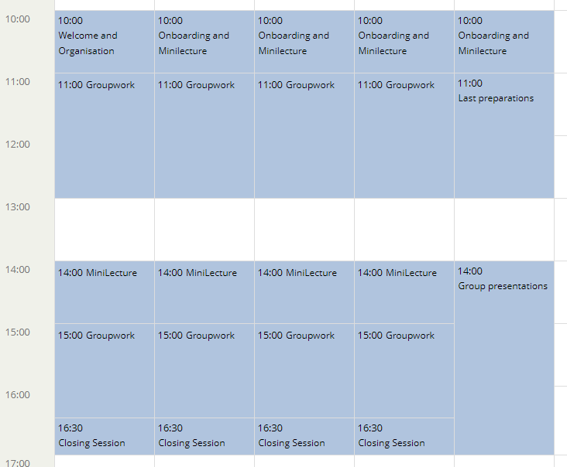
Timetable Blockweek

Slide 4
Blockweek Topics
Groupwork on a practical Usability Engineering topic
Prototyping & testing of an app or an application
Prepared ideas + your own choice

Slide 5
Blockweek Project
Overall structure:
Prep: user, context (A), requirements(B)
Design: (C)
Test: (D) Screensharing, Thinking aloud
2. Iteration
Case 1: „DEE – Notification & News System“
Case 2: „DEE – Preference Wizard“
Case 3: „DEE – Student Journey Planner“
Generic Case 4: „New Product“

Slide 6
Artifacts
Based on the user centered design
Step A "Context of use":
- User (Persona or target group description)
- Context (User Stories, Szenarios or Use Cases)
Step B "Requirements & Detailed Use Cases":
- Detailed use cases => test scenarios
- List of most important functional and non-functional requirements
Step C "Design":
- digital paper-prototype(case 1, 2, 4), allowing to test your most important contexts(see Step A)
Step D "Evaluation": - Test Protocol

Slide 7
Timetable
Monday:
- A complete + start with B
Tuesday morning:
- B complete
Tuesday afternoon:
- Start with C
Wednesday:
- C complete and first pretest
Thursday:
- D complete: tests (and support methods, like interviews, etc.)
Friday morning:
- checking results and preparing presentations

Slide 8
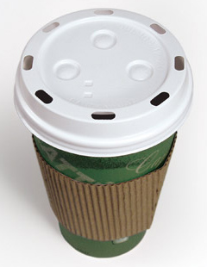
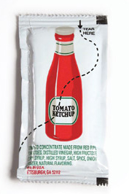

From the users point of view

Slide 9
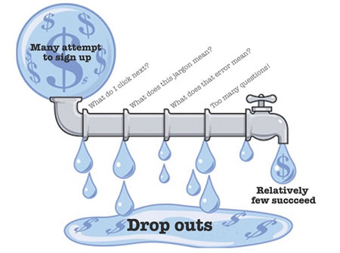
Web-Usability
Source: http://www.90percentofeverything.com/2006/11/13/bad-usability-is-like-a-leaky-pipe/

Slide 10
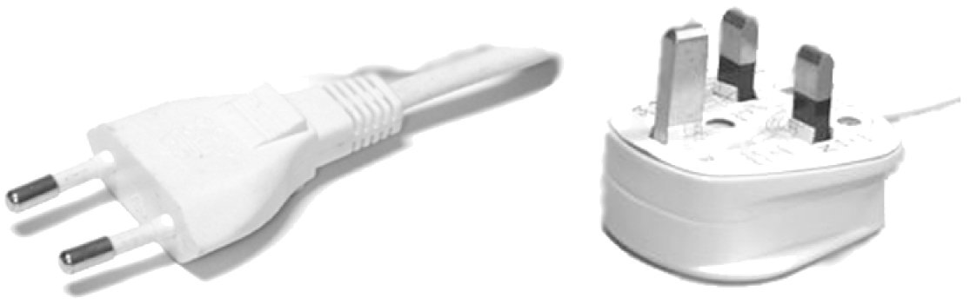
Standards? Why?

Slide 11
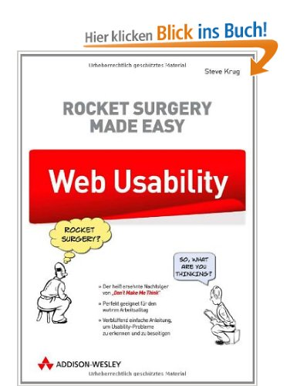
Some Standards...
EN ISO 9241, e.g.
Part 11, Usability Statements
Part 210, User Centered Design Process
Guidelines, e.g.
Discount Usability, Nielson
8 Golden Rules, Shneiderman
Etc.
Literature, e.g.
Academic background: Nielson, et al.
http://www.webdesign-und-usability.de
http://www.art-of-web-usability.de
http://www.bestviewed.de
http://www.useit.com
http://www.webpagesthatsuck.com

Slide 12
Contact
Prof. Dr. Christian Reimann
Professor for Informatics, Media Informatics
University of Applied Sciences and Arts Dortmund
Faculty of Computer Science
Emil-Figge-Str. 42 - 44227 Dortmund
Office: EFS 42 C.2.44
Phone +49 231 755-6786
Fax +49 231 755-6275
christian.reimann@fh-dortmund.de
www.fh-dortmund.de

